Slide 1

GloVeTune: A Machine Learning and Deep Learning Based Approach for Transcending Hotel Review Analysis through Pre-Trained Embeddings
Presented By-
Mohammad Nasif Sadique Khan
A S M Nasim Khan
Md Fardin Rahman Ami

Slide 2
Introduction
User-generated feedback and reviews play a crucial role in influencing the decisions of prospective visitors in the hospitality industry.
The foundation of the system is sentiment analysis, which involves categorizing reviews into positive and negative sentiments.
The proposed system leverages a diverse set of models including k-Nearest Neighbors(KNN), Multinomial Naive Bayes (MNB), Logistic Regression,Decision Tree, Random Forest, Support Vector Classifier (SVC),AdaBoost, Multi-Layer Perceptron (MLP), Attention-based Long Short-Term Memory (ATTENTION-LSTM), Recurrent Neural Network (RNN) with LSTM and Convolutional Neural Network(CNN) with (LSTM).
Each model was individually trained ona scrupulously preprocessed dataset, which included extensive data modification and feature extraction.

Slide 3
Data Collection
The data was scraped from Kaggle which contains 515,000 customer reviews and scoring of 1493 luxury hotels across Europe taken fromBooking.com
Our dataset comprises reviews both positive and negative, where positive review holds 70% of the totaland 30% being negative.
We have split our dataset in 80-20 ratio for train-test purpose.
This eclectic collection of text based data forms the foundation for training and evaluating our sentiment analysis models, enabling accurate classification of sentiments as positive or negative, ultimately driving deep insights for effective decision-making in the hotel industry.
\

Slide 4
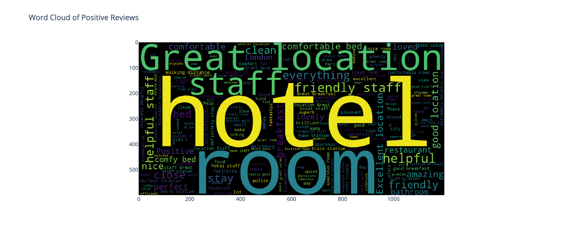
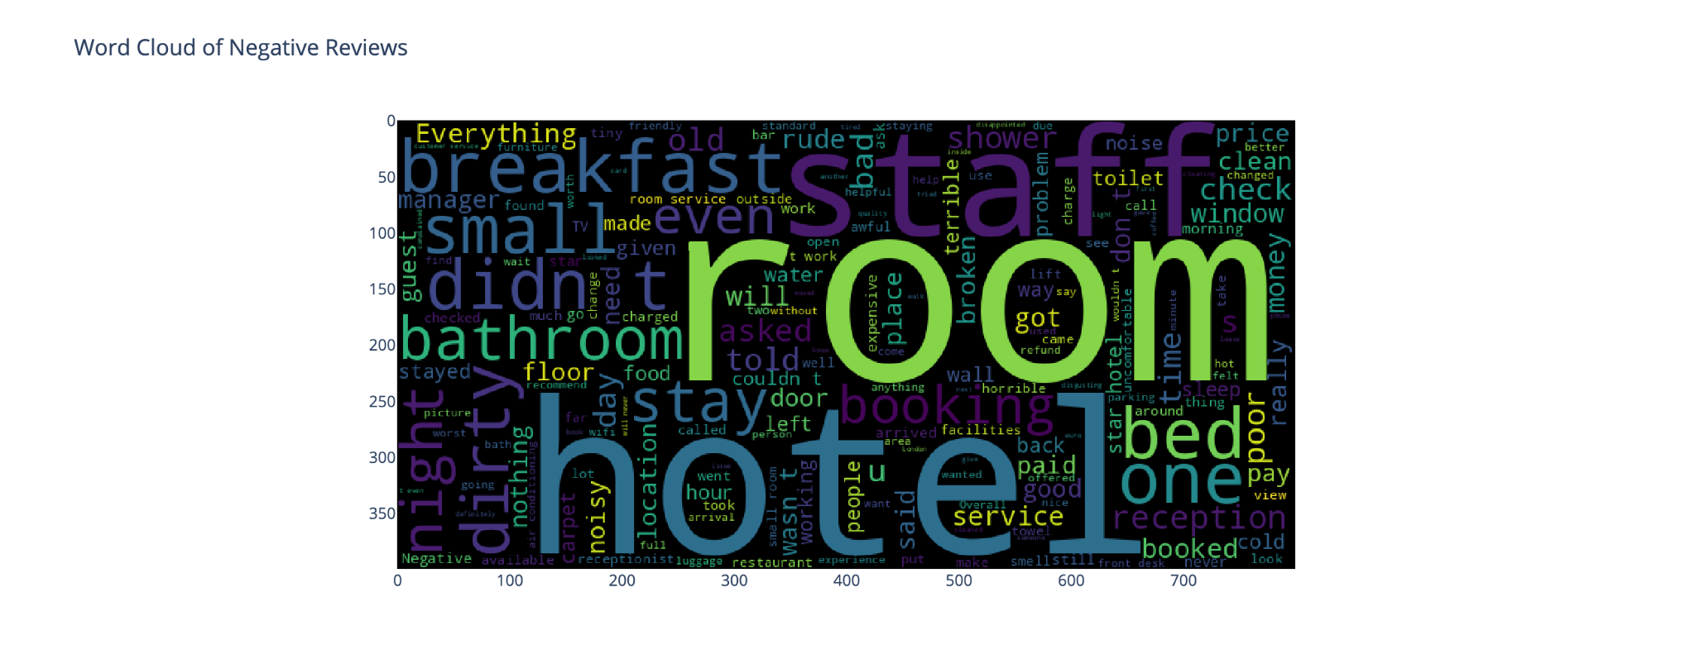
Data Analysis

Slide 5
Used Models (Non-Neural Models)
Multinomial Naive Bayes (MNB)
Support Vector Classifier (SVC)
K-Nearest Neighbors (KNN)
Random Forest
Decision Tree
Multi-Layer Perceptron (MLP)
Logistic Regression
AdaBoost
XGBoost

Slide 6
Used Models
(Neural/Attention Based Models)
Attention-LSTM
Recurrent Neural Network - LSTM (RNN-LSTM)
Convolutional Neural Network - LSTM (CNN-LSTM)

Slide 7
Pre Processing Steps
Removing special characters and punctuation:
[?!$%#&:</>]
Removing stopwords:
[am, is, the, was]
Lemmatization and stemming:
[going->go, cats-> cat]

Slide 8
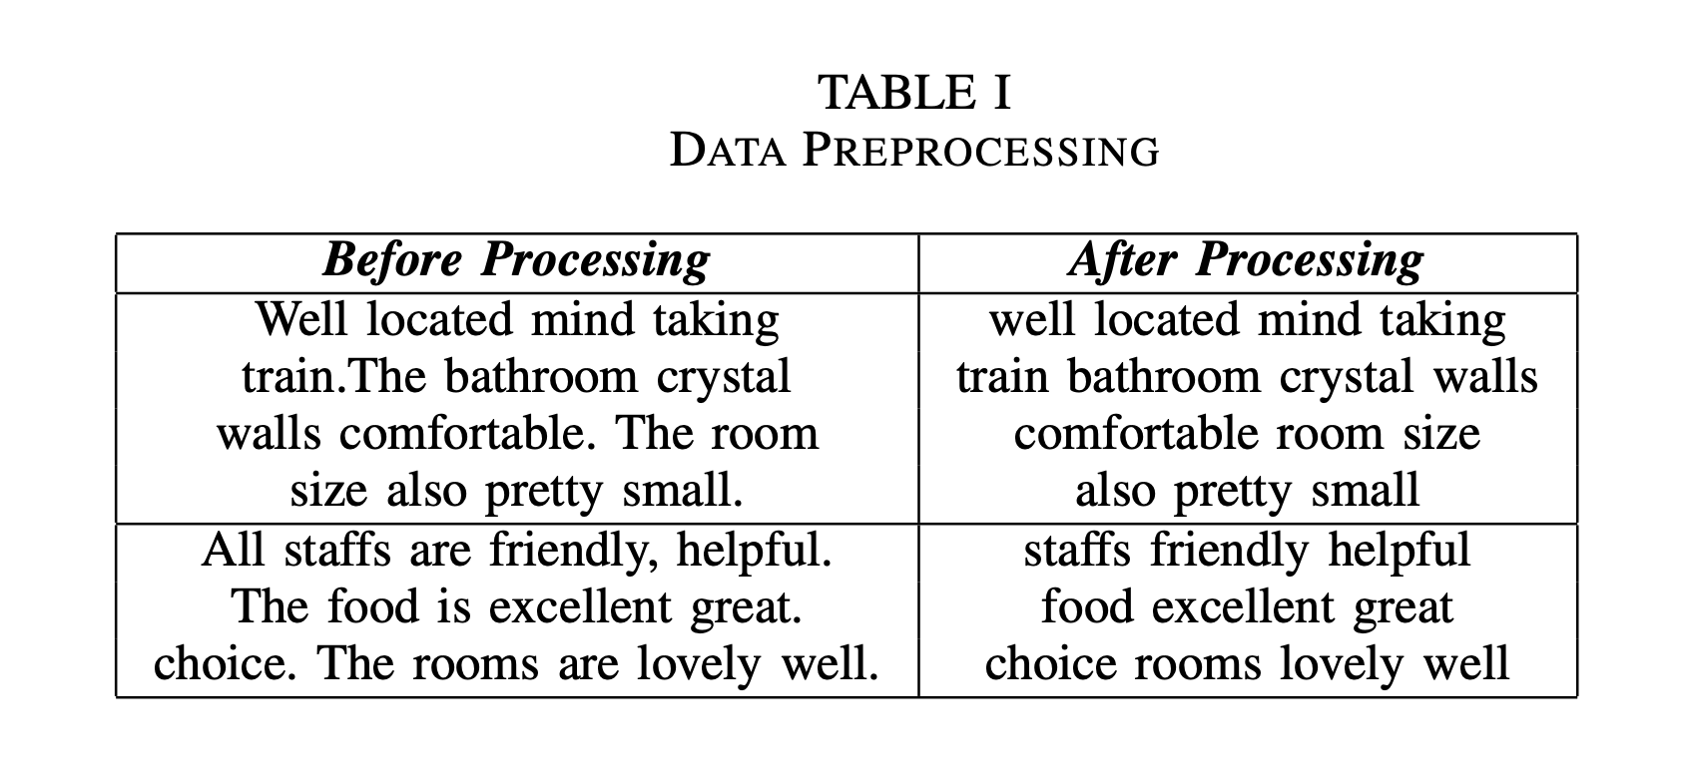
Pre-Processed Data Sample
Fig: dataset before-after preprocessing

Slide 9
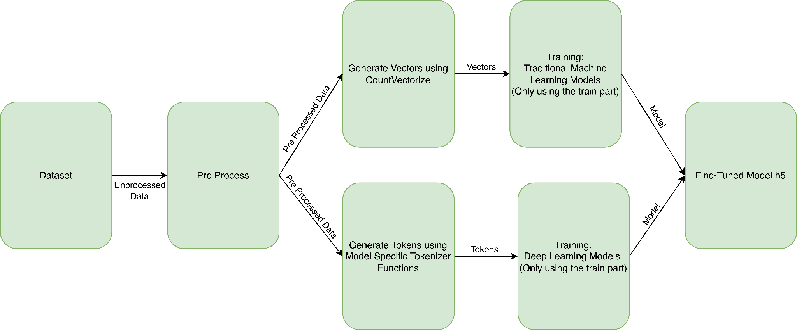
Training Phase

Slide 10
Methodology
The study compares conventional and deep learning methods for classifying texts as positive or negative reviews
After preprocessing steps CountVectorizer was used to generate vectors
SVMs, KNN, Bayes, Random Forest, Decision Tree, Perceptron, and Adaboost were used to analyze data.
In order to explore review prediction and find patterns, non-neural models were applied.

Slide 11
Methodology (Contd.)
The accuracy of review prediction can be improved by neural models incorporating attentional mechanisms.
Neural models with attention processes are constructed on the foundation of non-neural models.
Neural models, particularly those with attention mechanisms, RNN-LSTM, CNN-LSTM, have shown a remarkable ability in capturing complex patterns and relationships in intricate datasets.

Slide 12
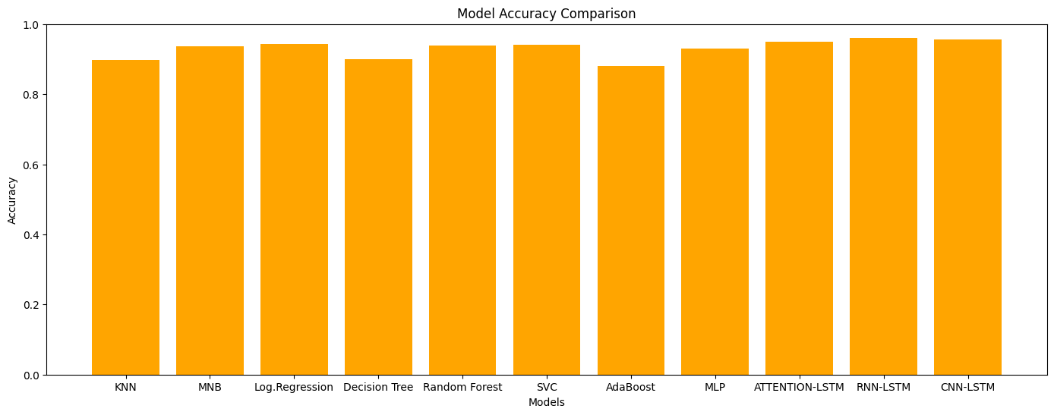
Accuracy Comparison
In general, most of the attention based models worked better than General ML models

Slide 13
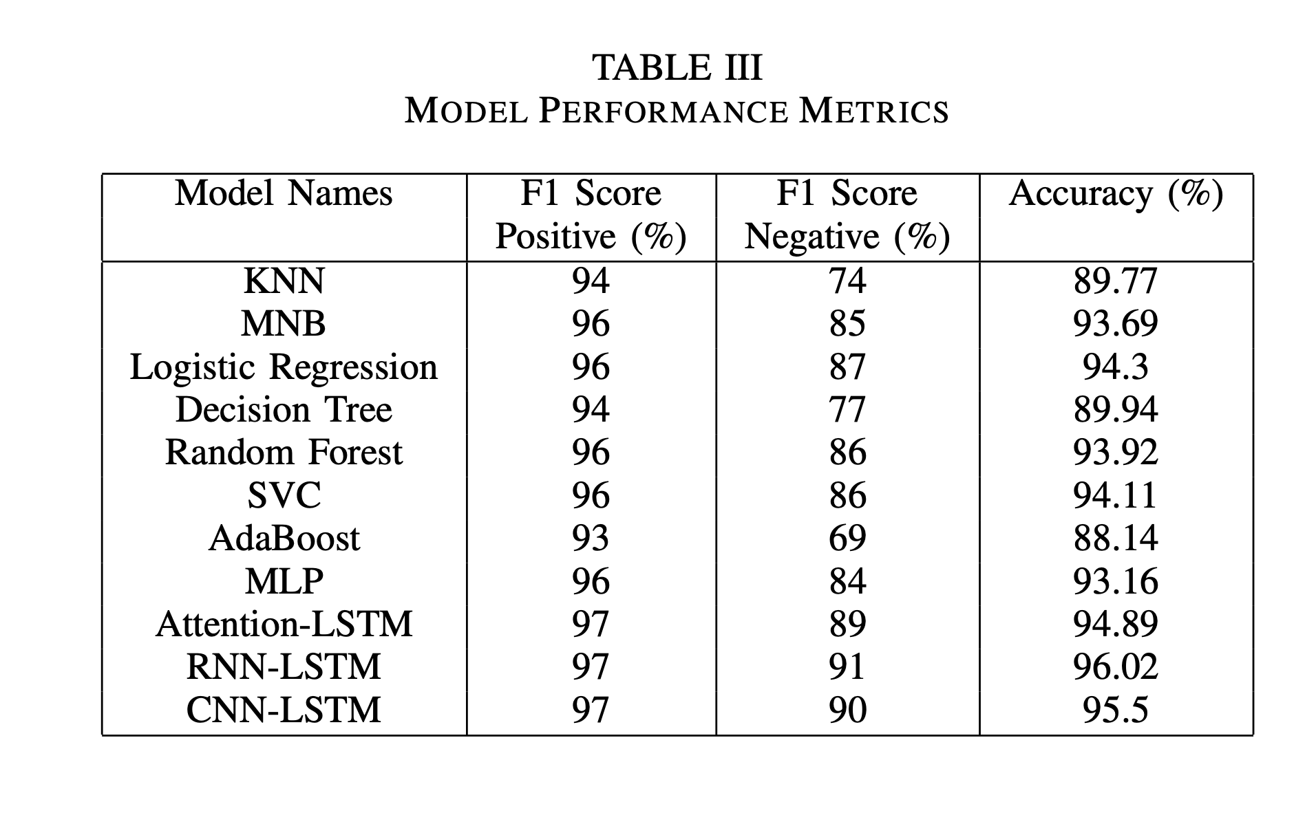
A table comparing the Accuracy and F1-Scores

Slide 14
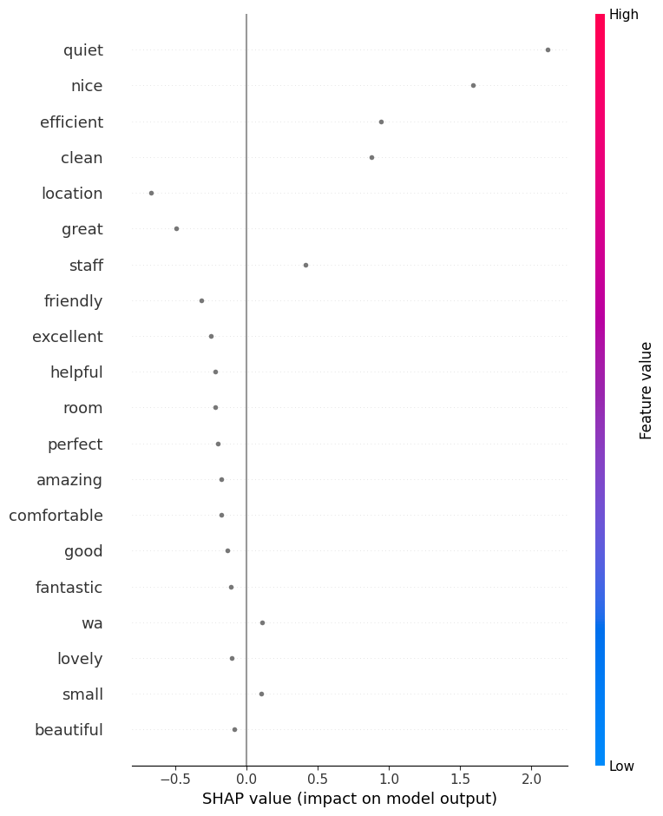
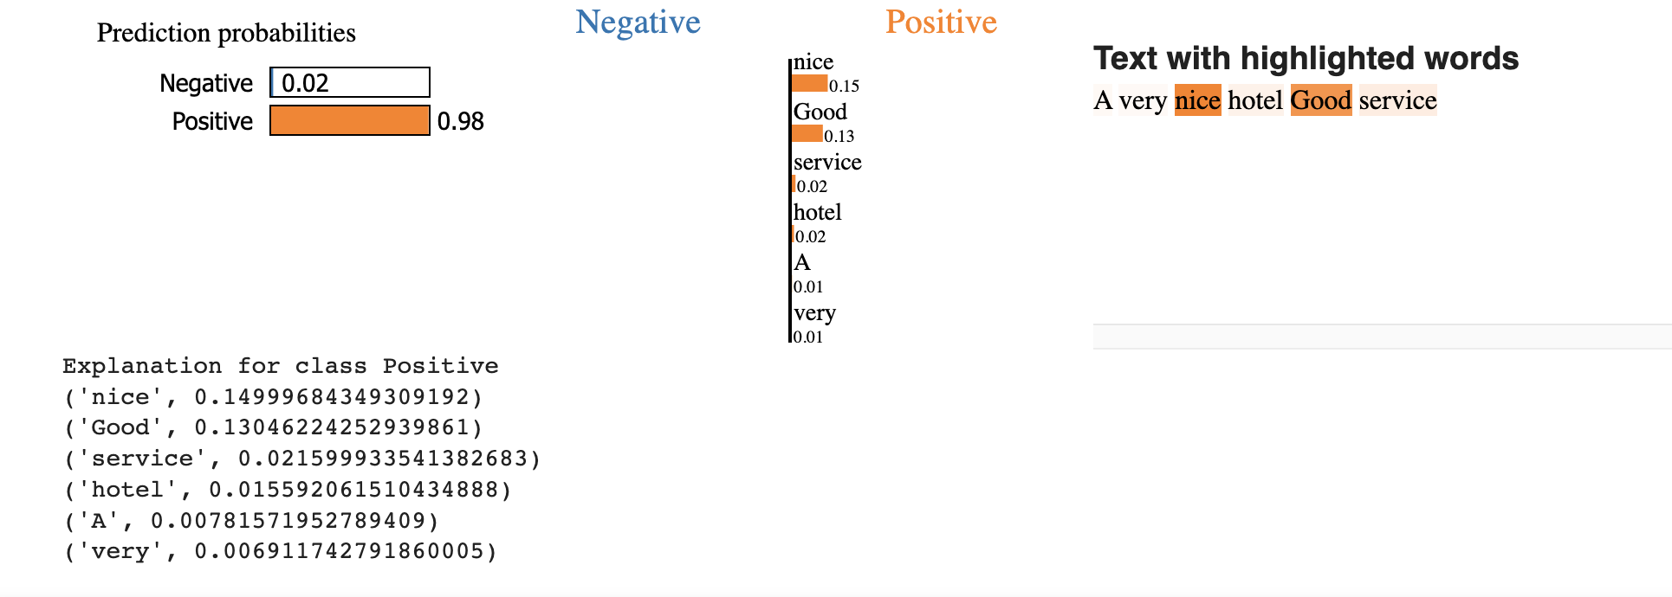
XAI part
SHAP xai
LIME xai

Slide 15
Conclusion
Through the utilization of advanced deep learning architectures, the system effectively processed and understood feedback from several languages, leading to enhanced levels of precision and reliability in hotel suggestions.
The RNNLSTM and CNN-LSTM models exhibited their adeptness in capturing the subtleties of customer input, hence enabling the system to effectively identify emotions and thoughts across several languages.
The sentiment analysis task exhibited a notable level of accuracy, as evidenced by the constant attainment of F1 scores over 90% by both models.
The use of deep learning models, namely RNN-LSTM and CNN-LSTM, enhances the system's ability to comprehend the sentiment-label characteristics of client feedback, thus enhancing the overall quality of hotel suggestions.

